Slide 1
R1 TRAINING UPDATE
How a grasp adjustment raised benchmark success from 81% to 85%
Cesar A. Pascal Vasquez
October 1, 2026
R1 improvement 1
Notes:
This update concerns the fixed-pelvis, right-arm R1 + Revo 2 task from the Week 23 project. The design follows the previous weekly presentation. The 85% result is a reused-benchmark result following tuning, not a fresh test estimate.
Sources
/Users/cesarpascal/Documents/Training/week 23 research/results/training_summary.json
/Users/cesarpascal/Documents/Training/week 23 research/results/final_policy_evaluation.json

Slide 2
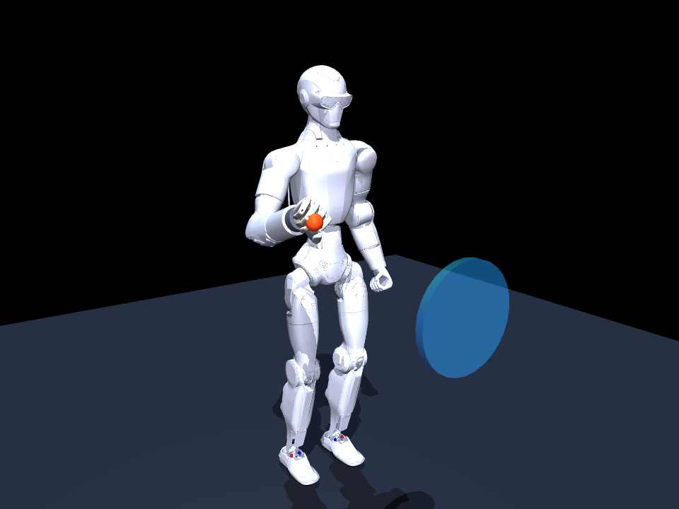
The R1 learns corrections to a reference motion
The fixed-pelvis R1 uses its right arm and Revo 2 hand to reach, grasp, hold, and throw a ball.
The CPU-trained network controls 5 arm joints and 6 active hand joints.
51 inputs, two 128-unit tanh layers, 11 outputs.
The learned corrections adjust a timed reference at 40 Hz.
Right-arm model, rendered in MuJoCo
R1 improvement 2
Notes:
The policy is a residual MLP, so the reference already supplies task structure. The untrained comparison also retains that reference. The ball fixture remains active to 2.90 s, approach contact starts at 1.48 s, and weight compensation continues briefly to 3.00 s. These curriculum aids are part of the task. The experiment does not demonstrate unsupported whole-body manipulation.
Sources
/Users/cesarpascal/Documents/Training/week 23 research/scripts/neural_policy.py
/Users/cesarpascal/Documents/Training/week 23 research/scripts/r1_revo2_env.py

Slide 3
The baseline learns from demonstrations and corrections
1
Collect 240 randomized teacher episodes with scripted IK actions.
2
Fit the residual network with 3,600 Adam updates on CPU.
3
Add two DAgger rounds with 60 episodes and 1,800 updates each.
4
Balance the six motion phases when sampling training batches.
63,985 state/action samples produced the 81% baseline
R1 improvement 3
Notes:
Behavioral cloning minimizes weighted imitation error against a scripted teacher. DAgger adds teacher labels on states visited by a mixture of teacher and network actions. The baseline used batch size 512 and arm/hand output weights 4.0/1.5. Demonstrations randomize geometry, ball properties, control gains, delay and observations. These counts refer to the established baseline, not the later failed challengers.
Sources
/Users/cesarpascal/Documents/Training/week 23 research/results/training_summary.json
/Users/cesarpascal/Documents/Training/week 23 research/scripts/train_policy.py

Slide 4
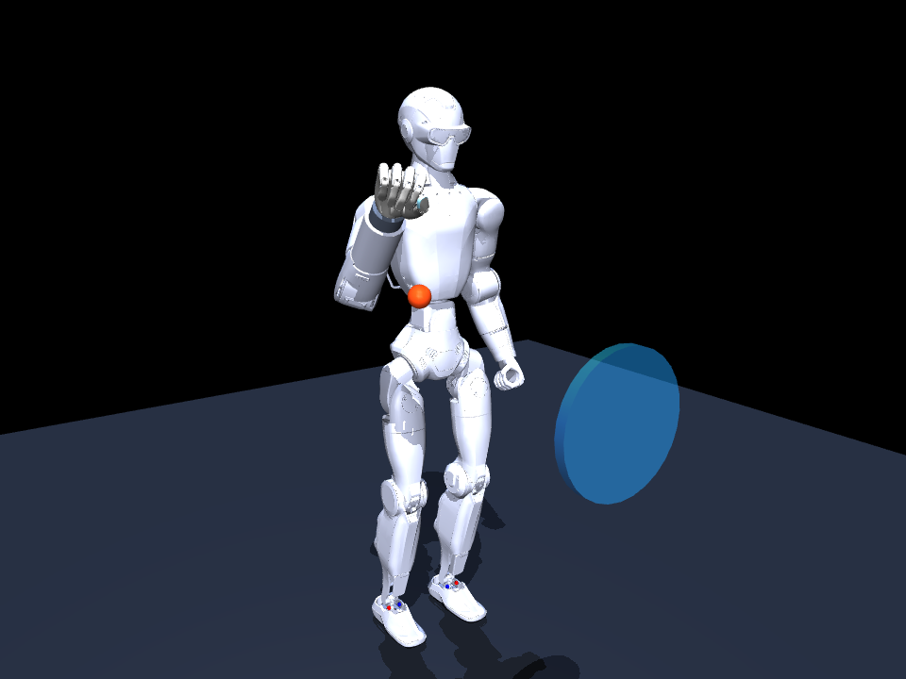
Before training: the random network loses the ball
FAIL
one illustrative episode
33.0 mm
minimum reach error
No grasp or throw
Randomized seed 53002
Click video to play
R1 improvement 4
Notes:
Click the video in Slide Show view. This is a newly recorded MuJoCo rollout of the random seed-23 MLP, using the same randomized environment seed 53002 as the next two recordings. It is a single example, not a measured 0% population rate. The reference trajectory remains active.
Sources
/Users/cesarpascal/Documents/Training/r1_improvement_presentation/build/media/evidence.json

Slide 5
The training challengers did not improve the baseline
Experiment | Training / adjustment | Success
Baseline | 128-unit layers, 63,985 samples | 81 / 100
Larger network | 192-unit layers, 91,091 samples | 69 / 100
More hand loss weight | 128-unit layers, 87,121 samples | 45 / 100
Reward search, best saved | Original weights retained | 81 / 100
Same 100 randomized benchmark seeds. The challengers changed multiple settings.
R1 improvement 5
Notes:
The 192-unit run used 300 teacher episodes and three 70-episode DAgger rounds. The hand-weighted run used 260 teacher episodes and three 75-episode rounds, with hand weight 3.2 instead of 1.5. Both started from initialization rather than fine-tuning baseline weights. Their score drops cannot be attributed to a single changed hyperparameter. The hand-weighted run also reduced reach success to 72%.
Sources
/Users/cesarpascal/Documents/Training/week 23 research/results/challenger_training_summary.json
/Users/cesarpascal/Documents/Training/week 23 research/results/hand_tuned_training_summary.json
/Users/cesarpascal/Documents/Training/week 23 research/results/reward_aligned_evaluation.json

Slide 6
The baseline reaches well but loses task completion
On the 100-episode benchmark, the baseline reaches in 100% of trials and grasps in 97%.
Hold and release each reach 88%. Full task success falls to 81%.
The evidence points toward retention and the throw stage as useful tuning targets.
Baseline grasp in the recorded example
R1 improvement 6
Notes:
These stage flags are marginal metrics and are not all a nested funnel. Full success requires reach, grasp, hold and throw. Release is a forward-speed criterion (>0.35 m/s), not an independent contact-based confirmation of release. Throw also requires >0.16 m forward displacement and target distance <0.50 m.
Sources
/Users/cesarpascal/Documents/Training/week 23 research/results/training_summary.json
/Users/cesarpascal/Documents/Training/week 23 research/scripts/r1_revo2_env.py

Slide 7
Before adjustment: the baseline throw falls short
14.3 cm
forward distance in this clip
16 cm
required distance threshold
Grasp and hold pass
The throw criterion fails
Click video to play
R1 improvement 7
Notes:
The baseline succeeds on 81/100 benchmark trials, but this selected recovered case at seed 53002 fails. It reaches, grasps, holds and passes the forward-speed criterion, but throws only 0.142511 m. The adjusted rollout on slide 13 uses the exact same seed, randomization and camera. Selection is illustrative and intentional, not a representative random sample.
Sources
/Users/cesarpascal/Documents/Training/r1_improvement_presentation/build/media/evidence.json
/Users/cesarpascal/Documents/Training/week 23 research/scripts/r1_revo2_env.py

Slide 8
Reward-based weight updates destabilized the policy
1
Start with the baseline and perturb only the final neural layer.
2
Run positive and negative perturbations on matched MuJoCo seeds.
3
Reward full success most, then hold, release, distance, and contact.
4
Keep the best policy from eight evolution-strategy iterations.
Baseline: 80% on 20 selection seeds. Updates: 0–20%. No gain.
R1 improvement 8
Notes:
The validation baseline was 80%, not 0%. The first ES update collapsed to 0%; the second reached 20%; the remaining updates scored 0%. The checkpoint selection retained the original baseline. This diagnoses an unsuccessful optimizer configuration, not a fundamental limit of reward learning. Reward: 12*success + 2*hold + 1.5*release + bounded distance/contact terms. Search used 6 antithetic directions, 3 episodes per direction, sigma 0.04 and learning rate 0.055.
Sources
/Users/cesarpascal/Documents/Training/week 23 research/results/reward_alignment.json
/Users/cesarpascal/Documents/Training/week 23 research/scripts/reward_finetune.py

Slide 9
Residual-gain tuning did not beat the trained setting
Change | Gains tested | Success on 50 seeds
All learned corrections | 0.70 / 0.85 / 1.00 / 1.15 | 54% / 60% / 76% / 22%
Hand corrections only | 0.75 / 0.90 / 1.10 | 72% / 74% / 76%
Reference baseline | Arm gain 1.0, hand gain 1.0 | 76%
Compare each sweep against 76% on its 50 seeds, not 81% on the full 100.
R1 improvement 9
Notes:
These sweeps used seeds 53000–53049. Damping all residuals weakened performance, and the tested larger global gain performed much worse. The hand-only sweep matched but did not exceed the corresponding 76% baseline. This is evidence about the tested gain values, not proof of an optimum.
Sources
/Users/cesarpascal/Documents/Training/week 23 research/results/residual_gain_0.70.json
/Users/cesarpascal/Documents/Training/week 23 research/results/residual_gain_0.85.json
/Users/cesarpascal/Documents/Training/week 23 research/results/residual_gain_1.00.json
/Users/cesarpascal/Documents/Training/week 23 research/results/residual_gain_1.15.json
/Users/cesarpascal/Documents/Training/week 23 research/results/hand_gain_0.75.json
/Users/cesarpascal/Documents/Training/week 23 research/results/hand_gain_0.90.json
/Users/cesarpascal/Documents/Training/week 23 research/results/hand_gain_1.10.json

Slide 10
The improvement adds closure during three phases
Adjustment
Phase | Extra closure
Reach | 0
Close, lift, windup | +0.08
Throw and follow-through | 0
Add +0.08 to the six normalized hand commands during close, lift, and windup.
The checkpoint keeps identical neural weights. It stores the bias as an extra policy parameter.
+0.08 in [−1, +1] equals 4% of the joint target range before clipping.
R1 improvement 10
Notes:
Implementation: decode_actions adds grasp_bias to outputs 5–10 when argmax(observation[1:7]) is 1, 2 or 3, then clips actions to [-1,1]. Nominal phase boundaries are 1.45, 3.00, 3.45 and 3.80 s. The extra bias ends at windup_end=3.80 s; the existing hand opening schedule begins at 3.88 s. No arm output offset is applied, but changed contacts can alter future state and therefore later network outputs. 0.08/2=0.04 of joint span, approximately 0.042–0.061 rad for the active hand ranges, before saturation. Checkpoint arrays verified identical.
Sources
/Users/cesarpascal/Documents/Training/r1_improvement_presentation/build/media/evidence.json
/Users/cesarpascal/Documents/Training/week 23 research/scripts/neural_policy.py
/Users/cesarpascal/Documents/Training/week 23 research/scripts/r1_revo2_env.py

Slide 11
A modest grasp bias gave the best sweep result
Extra hand command | Success | Hold / release
−0.04 | 74% | 82%
0.00 baseline | 76% | 86%
+0.04 | 82% | 90%
+0.08 selected | 84% | 92%
+0.12 | 82% | 92%
50 matched seeds per setting. Larger closure did not keep improving success.
R1 improvement 11
Notes:
The positive-bias sweep provides direct evidence for the small closure adjustment on these tested seeds. Selection used task success from MuJoCo rollouts, not gradients that trained new network weights. The winning +0.08 setting then scored 85/100 on the overlapping full benchmark.
Sources
/Users/cesarpascal/Documents/Training/week 23 research/results/grasp_bias_-0.04.json
/Users/cesarpascal/Documents/Training/week 23 research/results/grasp_bias_0.04.json
/Users/cesarpascal/Documents/Training/week 23 research/results/grasp_bias_0.08.json
/Users/cesarpascal/Documents/Training/week 23 research/results/grasp_bias_0.12.json
/Users/cesarpascal/Documents/Training/week 23 research/results/residual_gain_1.00.json

Slide 12
Why the grasp adjustment helped
More closure while carrying the ball
The added position target can tighten finger contact during lift and windup. Hold and release pass in 91 trials instead of 88.
The existing throw schedule remains available
The extra closure ends before the scheduled opening. Mean forward distance increases from 19.7 cm to 20.9 cm.
This is a plausible contact-mechanics explanation supported by the outcome changes. The logs do not establish a measured force increase.
R1 improvement 12
Notes:
Avoid claiming that every stage improves. Full-benchmark reach declines 100→99% and grasp 97→96%. Hold/release improve 88→91%, average peak forward speed 0.5808→0.6060 m/s and average forward distance 0.1971→0.2088 m. The contact-retention mechanism is a plausible interpretation, not a force measurement. The recorded seed 53002 already held successfully before the change, but its throw crosses the distance threshold afterward.
Sources
/Users/cesarpascal/Documents/Training/week 23 research/results/reward_aligned_evaluation.json
/Users/cesarpascal/Documents/Training/week 23 research/results/final_policy_evaluation.json
/Users/cesarpascal/Documents/Training/week 23 research/scripts/neural_policy.py

Slide 13

After adjustment: the same episode passes
16.7 cm
forward distance in this clip
PASS
all task criteria in this clip
Same seed 53002
85 / 100 on the benchmark
Click video to play
R1 improvement 13
Notes:
The improved checkpoint has bias +0.08 and the same w1/b1/w2/b2/w3/b3 arrays as the saved 81% baseline. This video is a fresh MuJoCo recording, not the older 81% video relabeled. It throws 0.167201 m on seed 53002 versus the baseline 0.142511 m. Both have successful reach, grasp, hold and forward-speed release flags. The clip is a selected recovered case.
Sources
/Users/cesarpascal/Documents/Training/r1_improvement_presentation/build/media/evidence.json
/Users/cesarpascal/Documents/Training/week 23 research/results/final_policy_evaluation.json

Slide 14
The benchmark improves by four percentage points
Metric | Baseline | Adjusted
Full success | 81 / 100 | 85 / 100
Reach / grasp | 100% / 97% | 99% / 96%
Hold / release | 88% / 88% | 91% / 91%
Mean forward distance | 19.7 cm | 20.9 cm
Mean peak forward speed | 0.581 m/s | 0.606 m/s
6 recovered cases, 2 regressions, 79 successes in both, 13 failures in both
These seeds informed tuning. A fresh randomized test set is still needed to confirm generalization.
R1 improvement 14
Notes:
Paired comparison uses identical seeds 53000–53099. Recovered: 53002, 53017, 53018, 53033, 53036, 53039. Regressed: 53005, 53010. This is a net 4/100 improvement and a descriptive 21.1% reduction in failures (19 to 15). Do not call the reused tuning benchmark an independent held-out final test, claim statistical significance, or report improved reach/grasp. Sources include both per-episode arrays and the derived pair counts.
Sources
/Users/cesarpascal/Documents/Training/week 23 research/results/reward_aligned_evaluation.json
/Users/cesarpascal/Documents/Training/week 23 research/results/final_policy_evaluation.json
/Users/cesarpascal/Documents/Training/r1_improvement_presentation/build/paired_results.json

Slide 15
The improvement is specific and measurable
What changed
A +0.08 hand command bias during close, lift, and windup raises the recorded benchmark from 81% to 85%. Neural weights remain identical.
Joint-range evidence
All 11 commanded joints stay inside the model limits in the three videos. Measured positions exceed a limit by up to 0.000973 rad (0.056°).
Next evidence needed
Fresh evaluation seeds and hardware-calibrated limits. These logs sample the simulation at 40 Hz and do not certify physical hardware safety.
R1 improvement 15
Notes:
Joint logs and their summaries correspond exactly to the embedded videos. They include 5 controlled R1 arm joints and 6 active hand joints at 40 Hz, not every passive joint or every physics substep. The maximum recorded limit excess is 0.000972537 rad across the three clips; this is within the earlier declared 0.001 rad simulation tolerance, but it is still a small strict limit exceedance. Real hardware signs, calibration, velocity/torque limits, and the approximate flange remain unverified. The fixed-pelvis and curriculum fixture also limit transfer claims.
Reproduction: build/render_evidence.py generates the videos and build/media/evidence.json records checkpoint SHA-256 hashes. No new training or promotion occurred for this presentation.
Sources
/Users/cesarpascal/Documents/Training/r1_improvement_presentation/build/media/evidence.json
/Users/cesarpascal/Documents/Training/r1_improvement_presentation/build/media/improved_joints.csv
/Users/cesarpascal/Documents/Training/week 23 research/model/r1_revo2_reach_throw.xml
/Users/cesarpascal/Documents/Training/week 23 research/README.md

